Slide 1
Learning from Examples
Example of Learning from Examples
  Classification: Is car x a family car?
  Prediction: What is the amount of rainfall tomorrow?
Knowledge extraction: What do people expect from a family car? What factors are important to predict tomorrows rainfall?

Slide 2
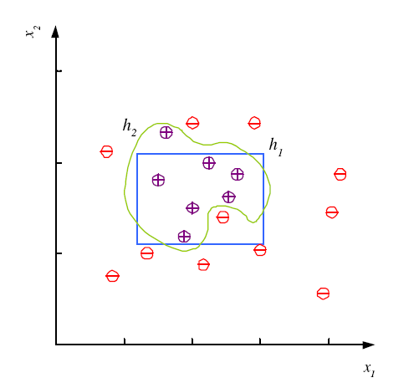
Noise and Model Complexity
Use the simpler one because
Simpler to use
(lower computational
complexity)
Easier to train (needs less examples)
Less sensitive to noise
Easier to explain
(more interpretable)
Generalizes better (lower
variance - Occam’s razor)

Slide 3
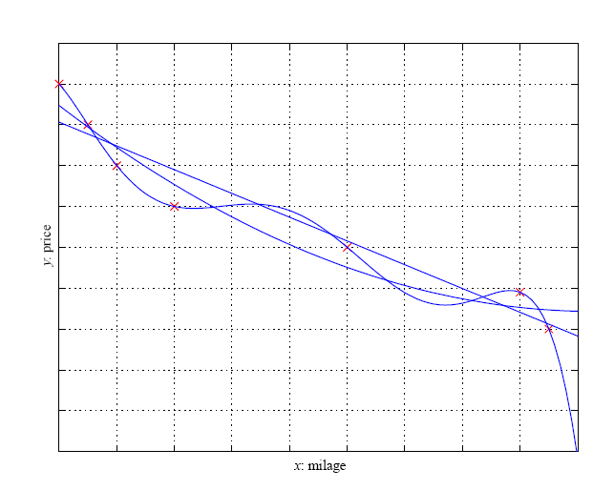
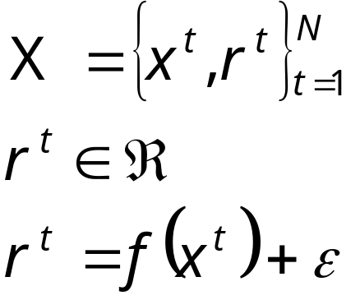
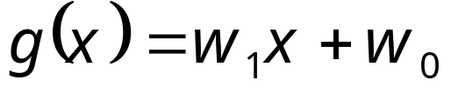
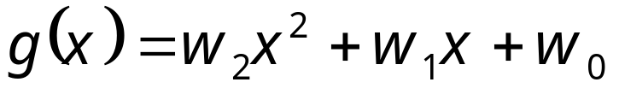
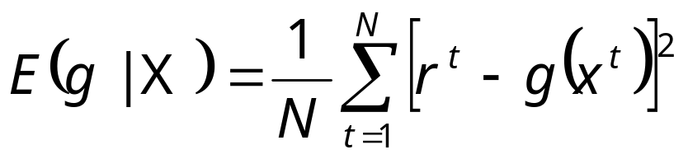
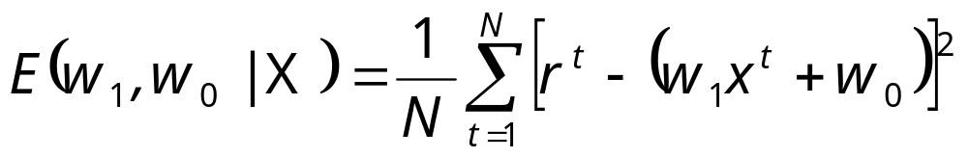
Alterantive Approach: Regression
Lecture Notes for E Alpaydın 2004 Introduction to Machine Learning © The MIT Press (V1.1)

Slide 4
Finding Regresssion Coefficients
How to find w₁ and w₀?
Solve: dE/dw₁=0 and dE/dw₀=0
And solve the two obtained equations!
Group Homework!
Lecture Notes for E Alpaydın 2004 Introduction to Machine Learning © The MIT Press (V1.1)

Slide 5
Model Selection & Generalization
Learning is an ill-posed problem; data is not sufficient to find a unique solution
The need for inductive bias, assumptions about H
Generalization: How well a model performs on new data
Overfitting: H more complex than C or f
Underfitting: H less complex than C or f

Slide 6

Underfitting and Overfitting
Underfitting
Overfitting
Complexity of a Decision
Tree := number of nodes
It uses
Complexity of the Used Model
Underfitting: when model is too simple, both training and test errors are large
Overfitting: when model is too complex and test errors are large although training errors are small.

Slide 7
Generalization Error
Error on new examples!
Two errors: training error, and testing error usually called generalization error (http://en.wikipedia.org/wiki/Generalization_error ). Typically, the training error is smaller than the generalization error.
Measuring the generalization error is a major challenge in data mining and machine learning (http://www.faqs.org/faqs/ai-faq/neural-nets/part3/section-11.html )
To estimate generalization error, we need data unseen during training. We could split the data as
  Training set (50%)
  Validation set (25%)→optional, for selecting ML algorithm parameters
  Test (publication) set (25%)

Slide 8
Triple Trade-Off
overfitting
There is a trade-off between three factors (Dietterich, 2003):
  Complexity of H, c (H),
  Training set size, N,
  Generalization error, E on new data
As N↑, E↓
As c (H)↑, first E↓ and then E↑
Αs c (H)↑ the training error decreases for some time and then stays constant (frequently at 0)

Slide 9
Notes on Overfitting
Overfitting results in models that are more complex than necessary: after learning knowledge they “tend to learn noise”
More complex models tend to have more complicated decision boundaries and tend to be more sensitive to noise, missing examples,…
Training error no longer provides a good estimate of how well the tree will perform on previously unseen records
Need “new” ways for estimating errors

Slide 10
Thoughts on Fitness Functions for Genetic Programming
Just use the squared training error →overfitting
Use the squared training error but restrict model complexity
Split Training set into true training set and validation set; use squared error of validation set as the fitness function.
Combine 1, 2, 3 (many combination exist)
Consider model complexity in the fitness function:
fitness(model)= error(model) + β*complexity(model)

